Slide 1
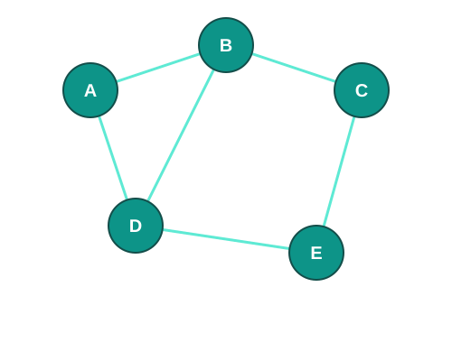
Graph Algorithms
From Zero to Contest Ready
CS Club • Problem-Based Learning

Slide 2
What Is a Graph?
A graph is a collection of:
Nodes (vertices)
The "things" — people, cities, pages, cells
Edges (connections)
The "relationships" — friendships, roads, links
Graphs model relationships between things.

Slide 3
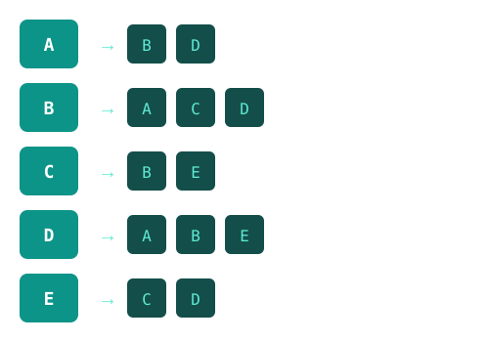
Representing Graphs in Code
Python — Adjacency List
# Build an adjacency list
graph = {
"A": ["B", "D"],
"B": ["A", "C", "D"],
"C": ["B", "E"],
"D": ["A", "B", "E"],
"E": ["C", "D"]
}
# Or build dynamically
from collections import defaultdict
graph = defaultdict(list)
graph["A"].append("B")
Adjacency List: For each node, store its neighbors

Slide 4
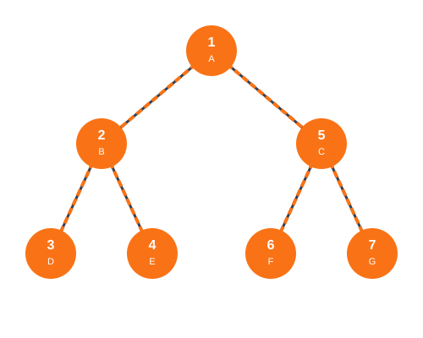
Depth-First Search (DFS)
Go as deep as possible before backtracking
def dfs(node, visited, graph):
visited.add(node)
print(node) # process
for neighbor in graph[node]:
if neighbor not in visited:
dfs(neighbor, visited,
graph)
# Start DFS
visited = set()
dfs("A", visited, graph)
Time: O(V + E) • Uses recursion (call stack)

Slide 5
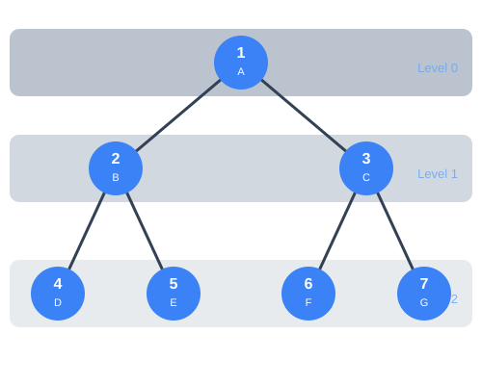
Breadth-First Search (BFS)
Explore level by level — finds shortest paths
from collections import deque
def bfs(start, graph):
visited = {start}
queue = deque([start])
while queue:
node = queue.popleft()
print(node) # process
for nbr in graph[node]:
if nbr not in visited:
visited.add(nbr)
queue.append(nbr)
Time: O(V + E) • Uses a queue • Guarantees shortest path in unweighted graphs

Slide 6
DFS vs BFS — When to Use Which
DFS — Depth-First Search
BFS — Breadth-First Search
Data structure: Stack / Recursion
Best for:
Exploring all paths
Connected components
Cycle detection
Topological sort
Backtracking problems
Data structure: Queue
Best for:
Shortest path (unweighted)
Level-order traversal
Minimum steps problems
Multi-source spreading
Rotting Oranges-style problems

Slide 7
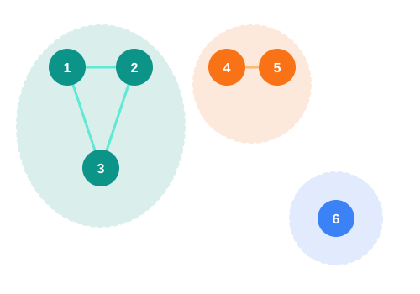
Connected Components
Groups of nodes that can reach each other
def count_components(graph, n):
visited = set()
count = 0
for node in range(n):
if node not in visited:
dfs(node, visited, graph)
count += 1 # new component!
return count
Key Insight: Each time you start a new DFS from an unvisited node, that's a new component

Slide 8
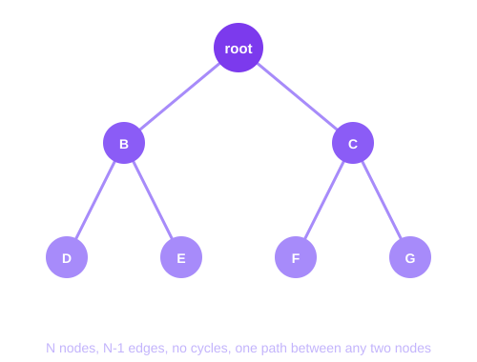
Trees — A Special Kind of Graph
A tree is a graph with:
N nodes, N-1 edges
No cycles
Fully connected
Exactly one path between any two nodes
Why it matters in CP:
Trees show up everywhere — file systems, HTML, org charts, and dozens of contest problems every season.

Slide 9
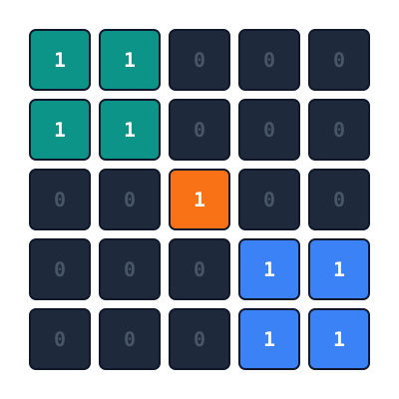
Grids Are Graphs Too
LeetCode 200 — Number of Islands
Each cell = a node
Adjacent 1s = edges
Each island = connected component
Answer = number of components
def numIslands(grid):
count = 0
for r in range(len(grid)):
for c in range(len(grid[0])):
if grid[r][c] == "1":
dfs(grid, r, c)
count += 1
return count
3 islands — 3 colors — 3 DFS calls from unvisited land cells

Slide 10
Data Structures for Graphs
set() — Visited Tracking
deque() — BFS Queue
dict / defaultdict — Graph
O(1) add and lookup
Track which nodes you've seen
Prevents infinite loops
O(1) popleft and append
First-In-First-Out (FIFO)
from collections import deque
Store adjacency lists
O(1) neighbor lookup
defaultdict(list) for building

Slide 11
Practice Problems — Start Here
LC #
Problem
Diff
Concept
733
Flood Fill
Easy
Basic DFS on grid
200
Number of Islands
Med
DFS + connected components
695
Max Area of Island
Med
DFS + tracking size
994
Rotting Oranges
Med
Multi-source BFS
542
01 Matrix
Med
BFS shortest distance
133
Clone Graph
Med
Adjacency list traversal
207
Course Schedule
Med
Cycle detection / topo sort
Start with Flood Fill. If you can solve that, you can solve Number of Islands. Then keep going.

Slide 12
Now Go Solve
VJudge Graph Competition
vjudge.net/contest/796073
Graph problems from today's lesson
Public leaderboard — compete against the club
We're watching the leaderboard.
Contest Season Is Now
RUCP & CALICO — April 11 • CMIMC — April 18 • PClassic — Late April • TSA States — May 2
Graphs show up in every single one of these.

